Slide 1

Block-chain based advanced industrial ERP System
AADITYA M NAIR
MCA S4-A

Slide 2
Contents
Relevance of Topic
Description
Objectives of Study
Existing System
Proposed System
Modules
Methodology
Algorithms
Front-end and Back-end

Slide 3
Relevance of Topic
Why do you need an advanced ERP system in 2022?
Better business performance.
Growth of business.
Improved response time.
Faster decision making.
Better than legacy system.

Slide 4
Description
An Enterprise Resource Planning (ERP) system is a software that helps business organization to standardize different process.
Procurement
Accounting
Project Management
ERP SYSTEM

Slide 5
Integrating ERP with Block-chain
Block chain technology is a technology that uses decentralized ledgers to keep transaction records.
Thereby it provides:
Security
Transparency
Less transaction time
No middle-men in transaction

Slide 6
Objectives of Study
To integrate blockchain with ERP :
To provide better transparency and security to data.
To determine methods that could effectively manage business activities.

Slide 7
Existing System
Centralized System
Lack of transparency
More chance of manipulation

Slide 8
Proposed System
Decentralized
Ensure transparency
No manipulation

Slide 9
Modules
Accounting
Ledger Management
Transaction
Procurement
Purchase
Stock
Project Management
Add project
Manage project

Slide 10
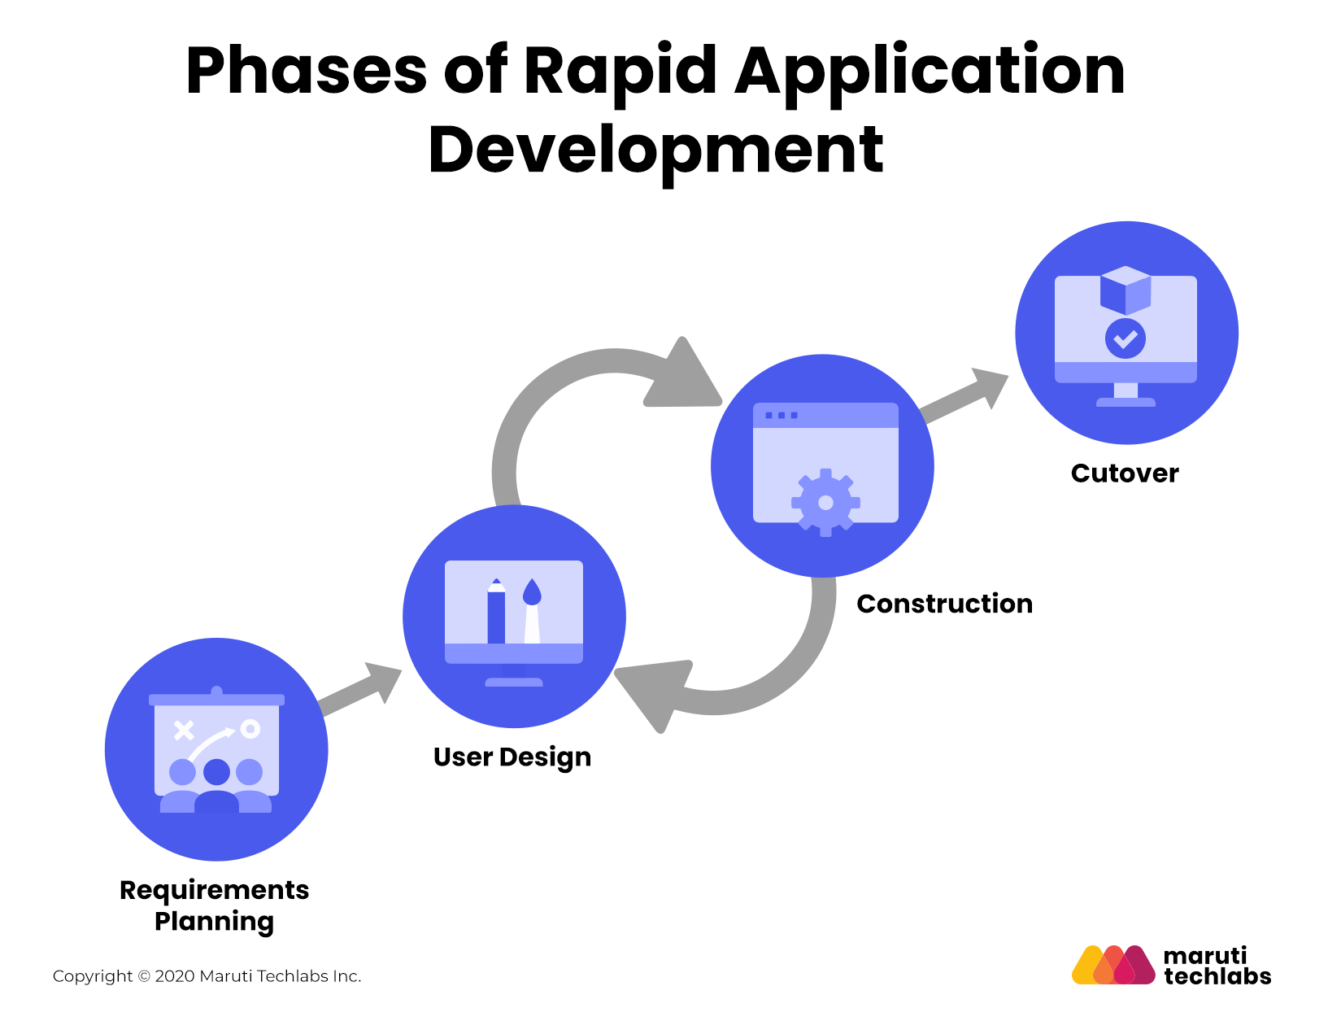
Methodology
The entire system is built using RAD methodology.

Slide 11
It provides :
High Quality Systems
Rapid/ Fast Development and Delivery
Low Costs

Slide 12
Algorithm
SSH Algorithm
SSH – Secure Shell
Used for encryption and transfer data securely over insecure network.
Only admin can decrypt using his secret key.

Slide 13
Front-end & Back-end
Front end - Asp.net
Back- end – SQL Server

Slide 14
THANK YOU

